Slide 1
Yasca
(Yet Another Source Code Analyzer)
Introduction
January 2008

Slide 2
Introduction
This presentation accompanies the Yasca User & Developer Guide and describes at a high level the purpose and benefit of Yasca.
Contents:
  What is Yasca?
  How does it work?
  How can it provide real value?
  Where to go from here?

Slide 3
What is Yasca?
Yasca is both an engine and a framework for conducting file analysis.
It was first designed to be a very basic source code analysis tool, but was extended using a "plugin" concept to allow for analyses for arbitrary file types.
Yacsa can be thought of as a glorified grep script, plus the ability to call out to external programs for separate analysis.
Architecture:
  PHP v4 (via command line)
    Compiled for Win32 so no dependency on PHP being installed.
    WinBinder DLLs for Win32 GUI
  No installation necessary, but one is available
  Can integrate into the Explorer context menu (on Folders)
Yasca is a tool for developers.

Slide 4
How does it work?
Yasca GUI
(windows only)
Yasca CLI
Target Files
Yasca Engine
Plugin
Plugin
Plugin
Plugin
Plugin
Report
Renderer
Report
Renderer
Report
Renderer
Output

Slide 5
Included Plugins
Yasca includes open-source components for some scanning:
    JLint (Java bytecode)
      Scans for bugs, inconsistencies, and synchronization problems
    antiC (Java, C, C++, Objective C source code)
      Scans for places where confusing language grammar can lead to bugs
    PMD (Java source code)
      Scans for bugs, dead code, suboptimal code, and overly complicated expressions
Additional plugins were written to find additional things:
    Cross-Site Scripting
    Race Conditions
    Temporary Files
    Licensing Restrictions on code snippets found on the Internet
    Weak Authentication (and more…)

Slide 6
Plugin Methodology
Yasca Engine
Grep
Grep File
Grep File
Grep File
Grep File
JLint
Plugins are distributed as source code, interpreted at runtime. Anyone can add a new plugin instantly!
antiC
Add your Own
Can be Java source code or an
XPath expression
PMD
Rulesets
Rule
Rule
Rule
Rule

Slide 7
Reporting
Canned Reports
  Rich HTML Output
  XML
  CSV
  Yasca could be modified to allow for additional report generators to be included at runtime.

Slide 8
Accuracy
This will be answered during the beta phase.
But…for a sample application (KDD):
 | = Critical | >= High | >= Medium | >= Low | >= Informational
Yasca (total) | 8 | 93 | 807 | 861 | 1619
Fortify (total) | 0 | 180 | 1069 | 2279 | 2279
Fortify (only) | 0 | 165 | 938 | 2039 | 1377
Yasca (only) | 8 | 78 | 676 | 621 | 717
Both | 0 | 15 | 131 | 240 | 902

Slide 9
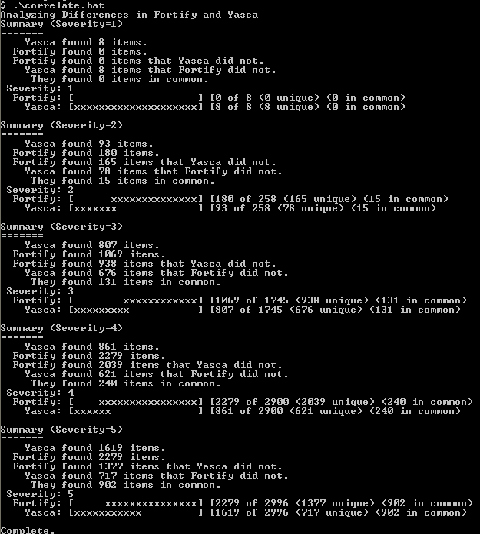

Slide 10
Accuracy
So what does Fortify do that Yasca cannot (yet)?
Null Pointer References:
  Foo x = getFoo();
  x = doSomething(x);
  x.quux(); ← No check against null
  Lack of Validation
    Yasca can do some of it
      Some flavors of XSS
      Some types of SQL Injection
      Intra-method taint propogation (in progress)
      Inter-method taint propogation (maybe in Q2)
  Plus all of the nice management stuff.

Slide 11
Future Improvements
User Interface:
  Prettier interface
  RAD plugin?
  Plugins:
  Additional plugins written as things are discovered or requested
    Involve ISD in the creation of these new plugins (message board!)
  Integration with other open source tools
    Dozens of candidates – focus on security
  Data Flow Analysis

Slide 12
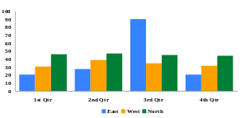
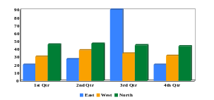

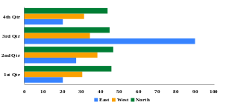

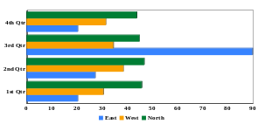
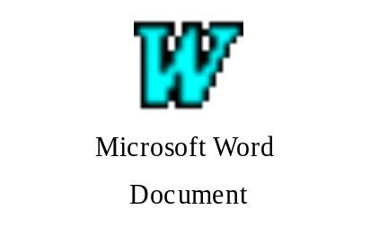
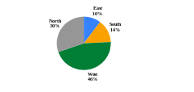
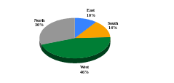
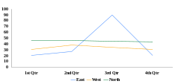
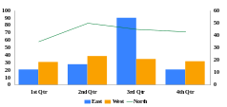
Questions?
A
A
A
A
A
A
A
A
A
A
A
A
A
A
A
A
A
A
A
A
A
A
A
A
A
A
A
A
A
Layout Box:
Select this box and use it to:
Insert text - type text and apply a style
Insert a Table or MS Graph
Resize an object
Layout Box:
Select this box and use it to:
Insert text - type text and apply a style
Insert a Table or MS Graph
Resize an object
Layout Box:
Select this box and use it to:
Insert text - type text and apply a style
Insert a Table or MS Graph
Resize an object
Layout Box:
Select this box and use it to:
Insert text - type text and apply a style
Insert a Table or MS Graph
Resize an object
Layout Box:
Select this box and use it to:
Insert text - type text and apply a style
Insert a Table or MS Graph
Resize an object
Layout Box:
Select this box and use it to:
Insert text - type text and apply a style
Insert a Table or MS Graph
Resize an object
A
[Name]
Tel: [+XX-XXX-XXX XXXX]
[email@XXXX]
Layout Box:
Select this box and use it to:
Insert text - type text and apply a style
Insert a Table or MS Graph
Resize an object
A
A
A
A
A
A
ABC
corp.
Layout Box:
Select this box and use it to:
Insert text - type text and apply a style
Insert a Table or MS Graph
Resize an object
Layout Box:
Select this box and use it to:
Insert text - type text and apply a style
Insert a Table or MS Graph
Resize an object
Layout Box:
Select this box and use it to:
Insert text - type text and apply a style
Insert a Table or MS Graph
Resize an object
Layout Box:
Select this box and use it to:
Insert text - type text and apply a style
Insert a Table or MS Graph
Resize an object
A
A
Layout Box:
Select this box and use it to:
Insert text - type text and apply a style
Insert a Table or MS Graph
Resize an object
Layout Box:
Select this box and use it to:
Insert text - type text and apply a style
Insert a Table or MS Graph
Resize an object
Layout Box:
Select this box and use it to:
Insert text - type text and apply a style
Insert a Table or MS Graph
Resize an object
Layout Box:
Select this box and use it to:
Insert text - type text and apply a style
Insert a Table or MS Graph
Resize an object

